Slide 1

BANKING MANAGEMENT SYSTEM
Submitted By :- Pritam Dhoke
Deepak Yadav
Himam Saheb
ROLL NO. : 46,47,48
SECTION : K17RZ

Slide 2
DESCRIPTION
In this we have worked for making banking simple.
These webpages can do lot of important things which is used by many banks.
We have used JavaScript to validate the user information so that it should not be uploaded wrong.
For the designing purpose some of inline & external css is used.

Slide 3
FLOWCHART
HOMEPAGE
Sign in
CREATE ACCOUNT
INTERNET BANKING
APPLY FOR LOAN
INTERNET BANKING
FAQS
ADMIN SIGN IN
CUSTOMER SIGN IN
P. L
E.L
CHECK ELIGIBITY
CUSTOMER SIGN IN
APPLY FOR LOAN
H.L
B.L
RATE%
ATTACH DOCUMENT
APPLY

Slide 4
WORK DIVISION
Pritam :
1. Homepage
2. Signup
3. Apply for Loan
4. Contact Us
5. About Us
6. Add Aadhar
Himam :
1. Internet Banking
2. Faqs
3. Login

Slide 5
TECHNOLOGY USED
HTML (Hyper Text Markup Language).
CSS (Cascading Style Sheets) .
JavaScript.
Notepad++

Slide 6
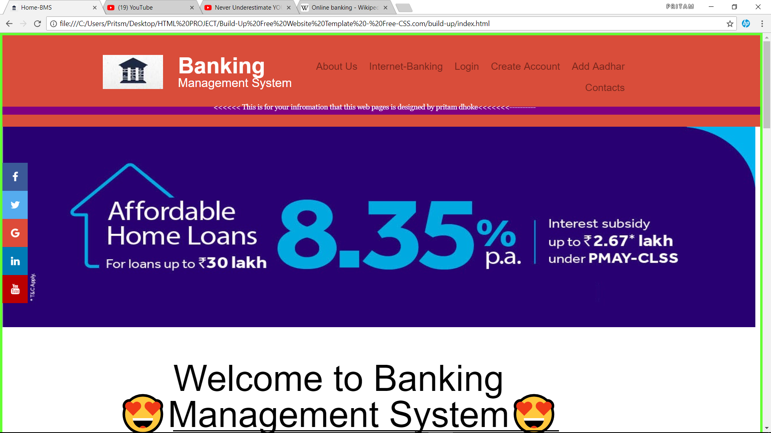
SCREENSHOTS :
Home Page

Slide 7
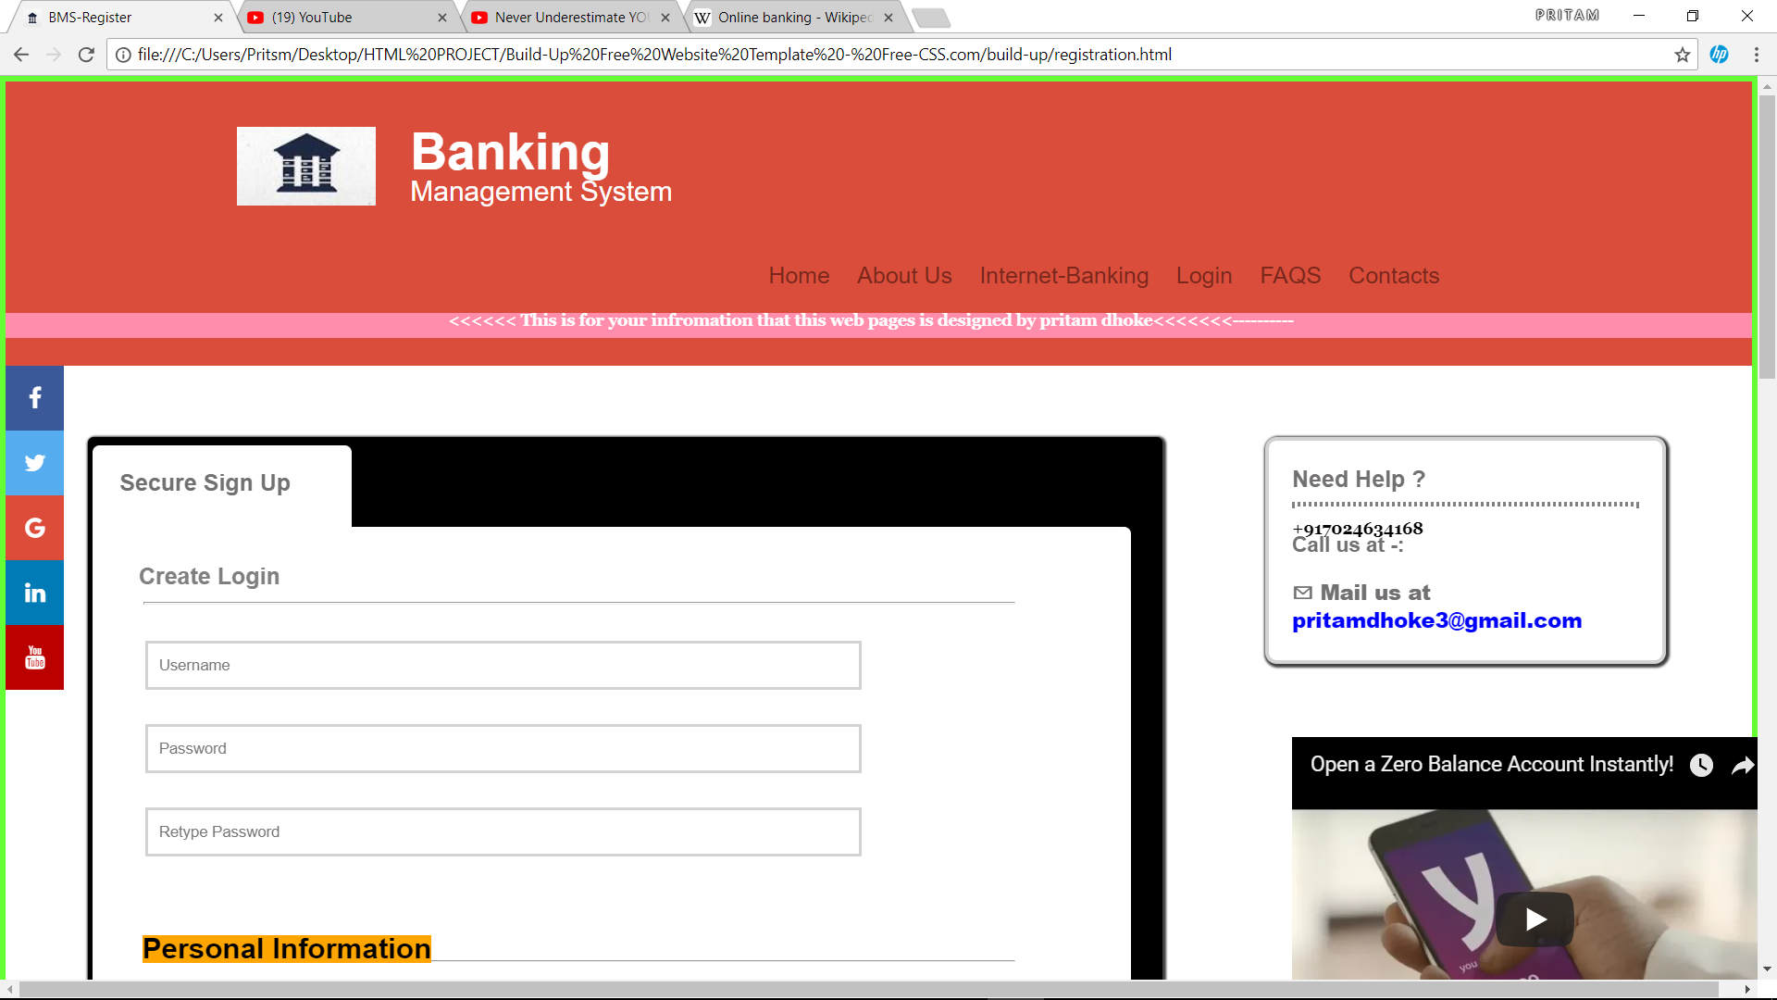
Sign up

Slide 8
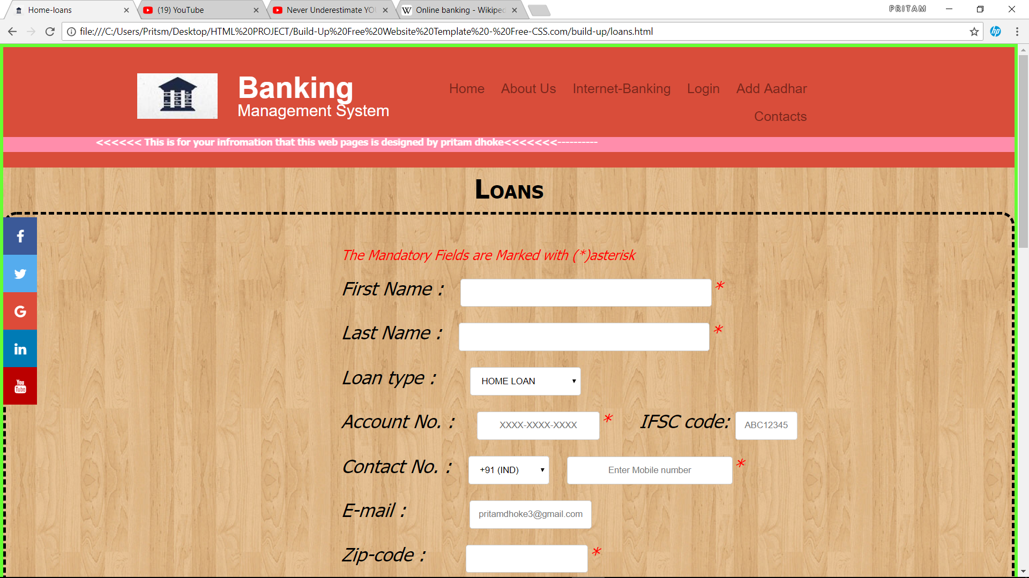
Apply for Loan

Slide 9
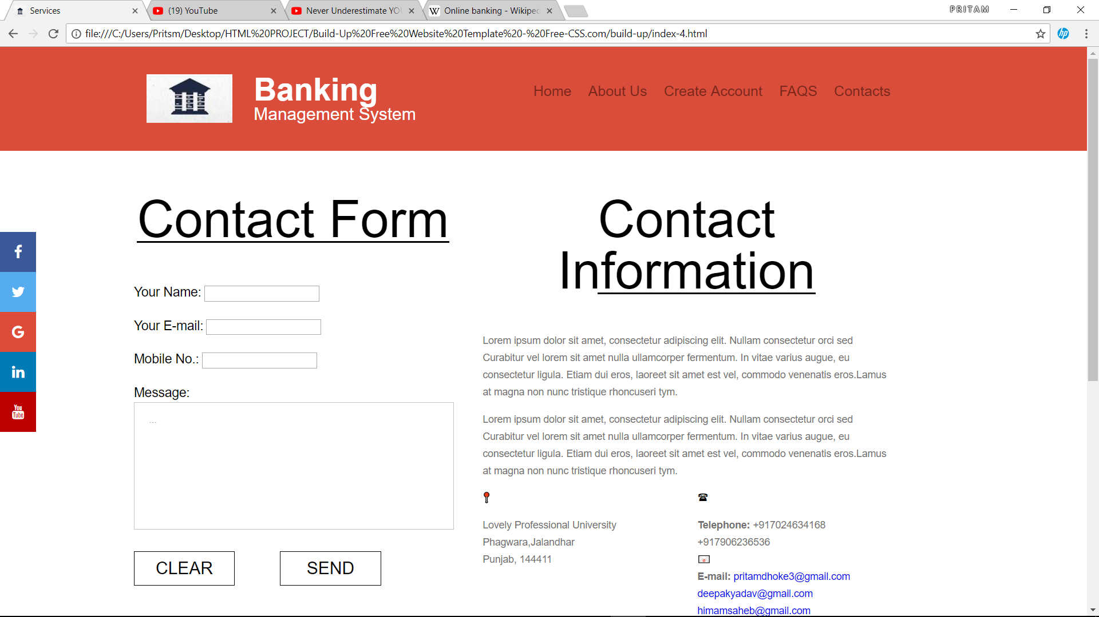
Contact Us

Slide 10
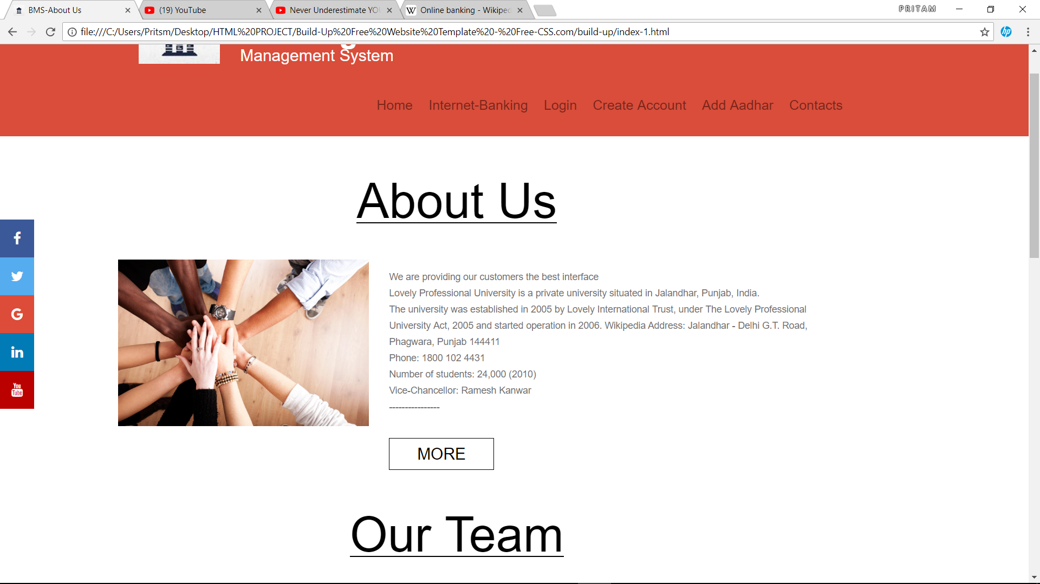
About Us

Slide 11
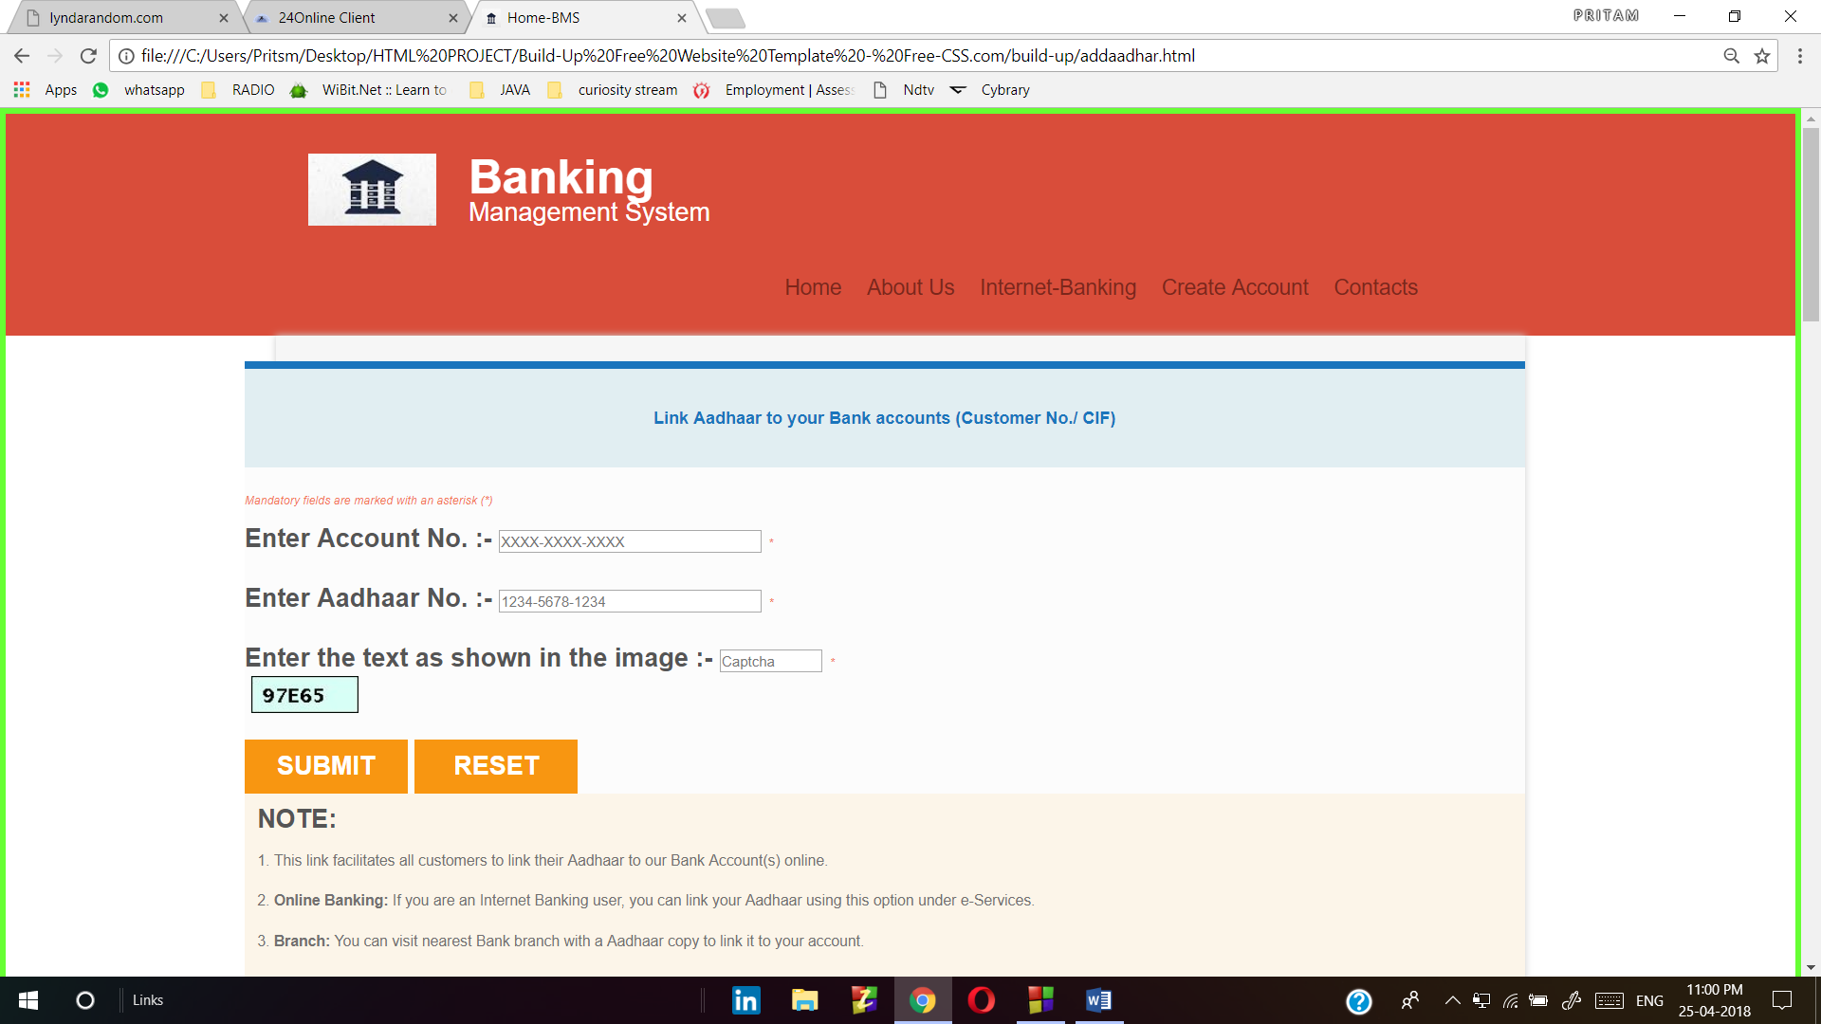
Add Aadhar

Slide 12
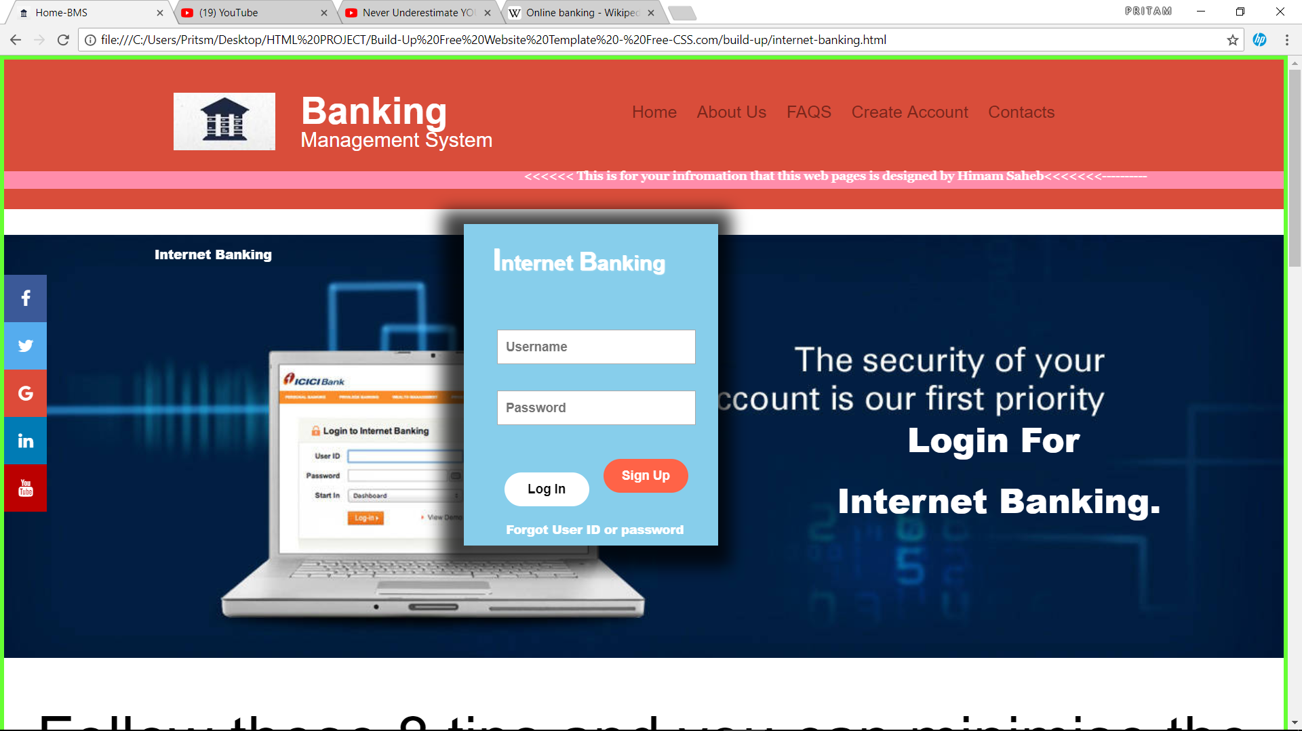
Internet Banking

Slide 13
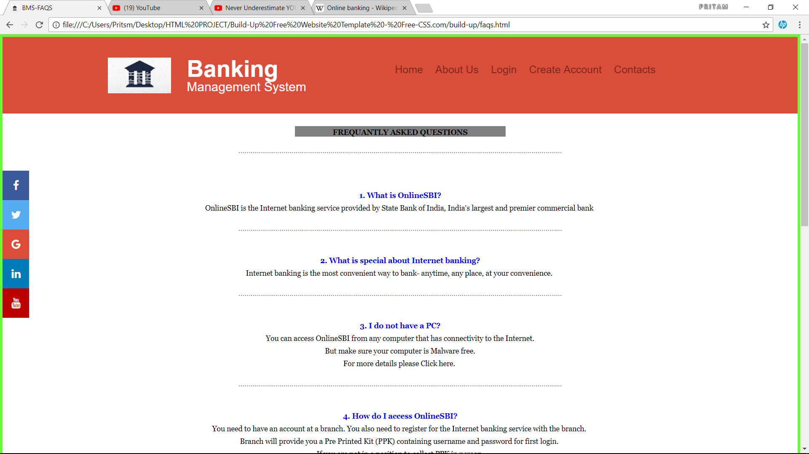
Faqs (frequently asked questions

Slide 14
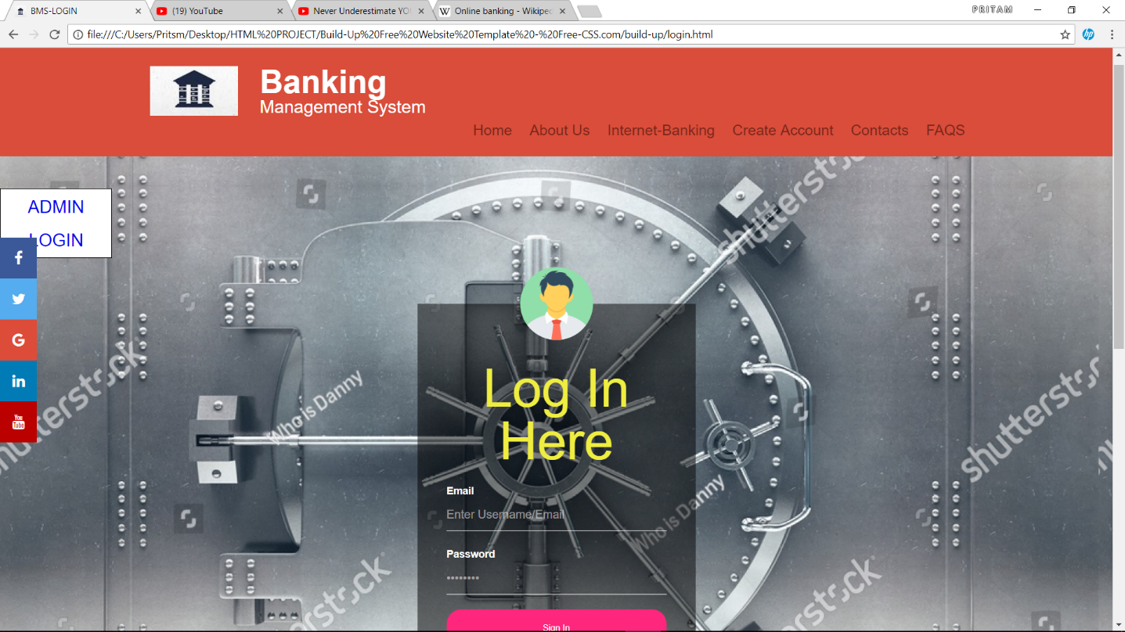
Login

Slide 15
THANK YOU

